Slide 1
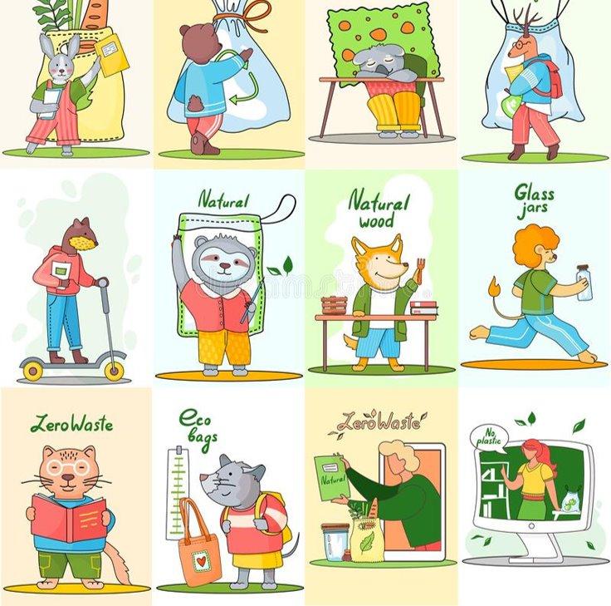
Waste Collecting strategy

Slide 2
Waste collecting strategy mind map

Slide 3
THE AMOUNT OF WASTE COLLECTED (KG)

Slide 4
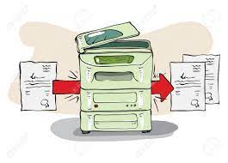
Waste collecting strategy
Less copying
No plastic bottles
Less consumption
More walking
no electricity waste
No water waste

Slide 5
Sustainable school Public event

